Slide 1

Sentiment Analysis of Twitter Data for predicting Apple stock price
Group4
Amit Sharma, Mihir Mehta, MANJARI SHUKLA, Richard Yoo

Slide 2


WHY Twitter?
Core Message
To analyze how Twitter sentiment affects the price of Apple stock (“AAPL”)
Twitter is a rich source of real-time information regarding current societal trends and opinions.

Slide 3


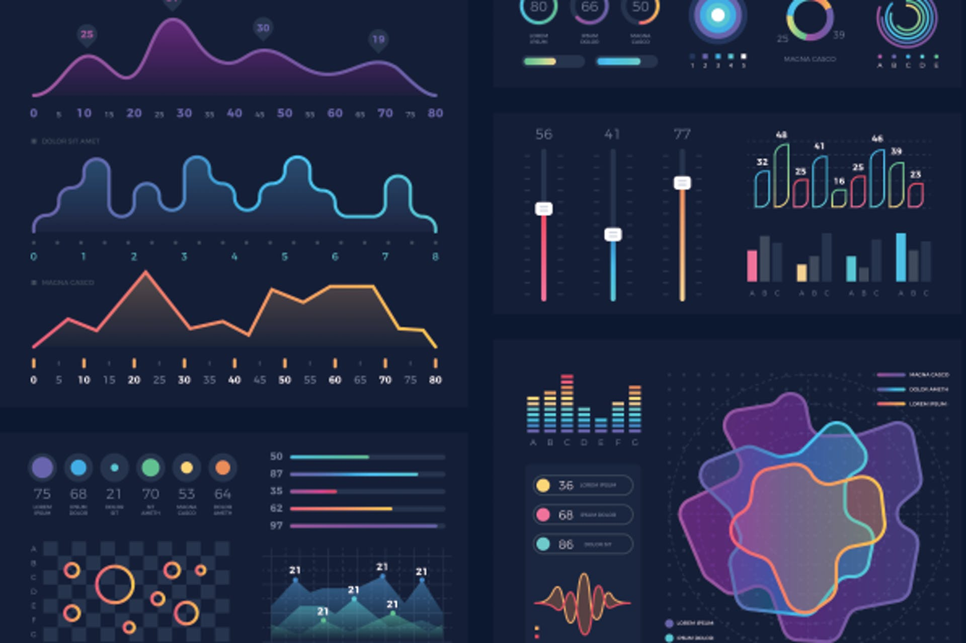
Data & Models
Twitter Data: Data from Kaggle (https://www.kaggle.com/nadun94/twitter-sentiments-aapl-stock)
Stock Data: Stock Price of Apple from Yahoo Finance.
Machine Learning Models:
Regression: LSTM, RF and XG Boost
Classification: RF and Gradient Boost
to fit the data and compare performance between models.
Data Visualization: hvPlot and Matplotlib.

Slide 4
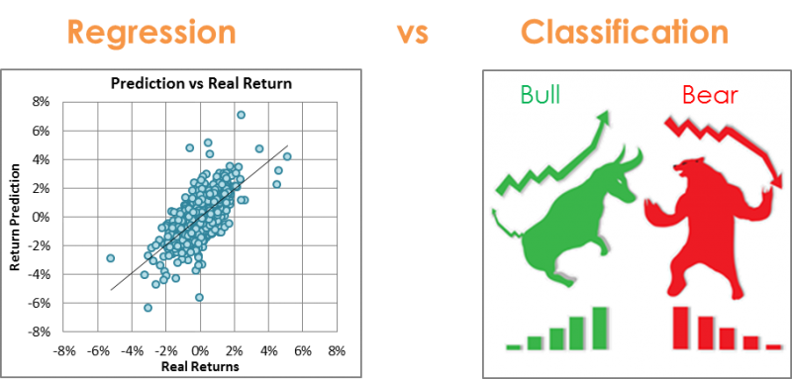
Source : https://www.kaggle.com/anniepyim/essential-classification-algorithms-explained

Slide 5
LSTM RNN
Random Forest Regressor
XG Boost Regressor
Random Forest Classifier
Gradient Booster
Source : https://www.kaggle.com/anniepyim/essential-classification-algorithms-explained

Slide 6
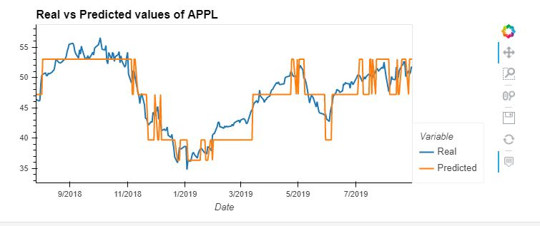
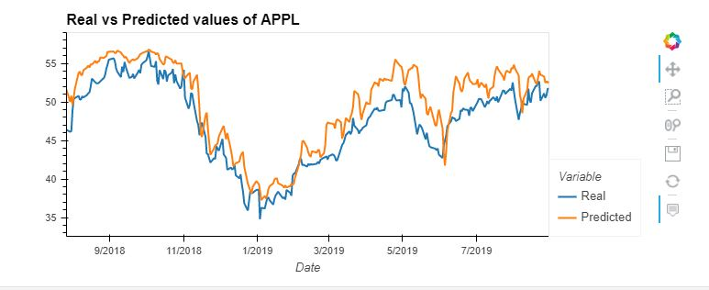
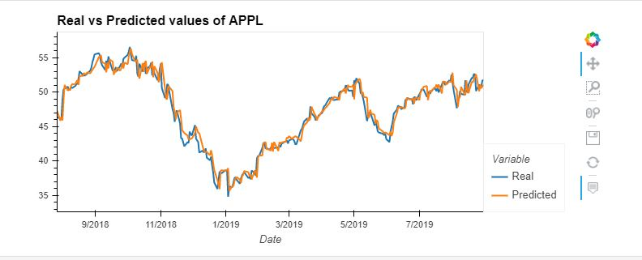
KEY FINDINGS <Regression Approach>
RF Regressor
R-Squared : 80.05%
RMSE : 0.1053
LSTM
Random Forest Regressor
XG Boost
LSTM
R-Squared : 68.01%
RMSE : 0.1334
XG Boost
R-Squared : 95.92%
RMSE : 0.0477

Slide 7
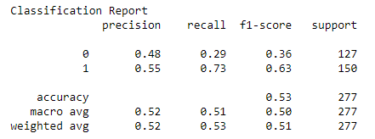
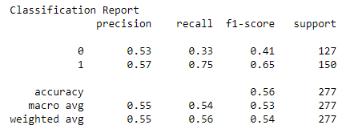
KEY FINDINGS <Classification Approach>
RF Classifier
Random Forest Classifier
Gradient Booster
Gradient Booster

Slide 8
Summary
Regression approach is a better approach for predicting stock price as opposed to classification approach
However, it is only applicable for APPL stock

Slide 9

Problems/Issues during data preparation and model training
Data preparation:
1) Getting AAPL stock data
2) Getting Twitter Data with “ts_polarity” and “twitter_volume”
3) Getting Twitter Data using Tweepy Library
Model Training:
Identifying optimum hyperparameters to fine tune the model outputs

Slide 10
Postmortem
Any Difficulties?
Finding Twitter Data
Machine Learning Models
Visualization
If we had 2 more weeks!!
Tweepy API/Library
News API headlines besides Twitter
New API/Libraries
More Machine Learning Models
More Visualizations
More Stocks/Market

Slide 11


